Slide 1

BFX-UA300 Control Run New FATP Result Report
Prepare by: PE: Thuc
Date : 2023.03.03

Slide 2
#1
Control Run Contents
Software
Process
ECN
Material
Other
V
1. Background Information:
Change production line from line 9 at F16-1F to line K2 at F07-3F site.
Quantity: 70pcs.
2. Purpose control run:
Verify new test environment at F07-3F site.
Check operation of test equipment after moving.
3. Control run process:
BT
PT
UP
A
Link
Burn in 6 minutes
Assy2
Assy 3
Assy 4
FT1
A
FT3
RC
RC1
OBA
FT2
Burn in 6 minutes
RC2
FG
Packing
4. Summary: Control run only verify new test environment and don’t change HW, SW , test program follow test plan.

Slide 3
#2
Control Run Procedure And Result
Step | Items | CTQ | Contents | Q’ty (pcs) | Result
1 | BC3F | None | Normal process | 70 | Pass
2 | BT,PT,UP station | Yes | Check boot up and TX,RX throughput (CPK TX,RX throughput value >1.33) | 70 | Pass
3 | Assembly ( Assy 2,3,4) | None | Assembly new housing ( check 100% button is stuck or normal ) | 70 | Pass
4 | FT1 | Yes | Test LED, Button, AUX,MIX functions | 70 | Pass
5 | FT2 | Yes | Test sound function (CPK values >1.33) | 70 | Pass
6 | FT3 | Yes | Test Bluetooth function (CPK Bluetooth RSSI value>1.33) | 70 | Pass
7 | RC | Yes | Upgrade customer software | 70 | Pass
8 | RC1 | Yes | Check scan QR code | 70 | Pass
9 | OBA | Yes | Check all function of product at customer software | 70 | Pass
10 | RC2 | Yes | Check scan QR code | 70 | Pass
11 | Packing→ FG | None | Normal process | 70 | Pass
Summary:
- CTQ stations: all station on FATP.

Slide 4
#3
Final Test Yield Rate
ALT |  |  | Model Name | BFX-UA300
 |  |  | Quantity | 70pcs
 |  |  | AMP board image | 0x32
 |  |  | Production image | v522r13e_fac-20210914
 |  |  | Customer image | 19.532.16
 |  |  | MO | 2643002655
 |  |  | Date | 03/01/2023
1.Product Yield & FA Report
Customer | Product Model | Test Station |  | Yield Rate | Statistical | Yield Rate
ALT | BFX-UA300 | BT |  | 100.00% | Total | 70
 |  |  |  |  | Pass | 70
 |  |  |  |  | Fail | 0
 |  |  |  |  | Yield Rate(%) | 100.00%
 |  | PT |  | 100.00% | Total | 70
 |  |  |  |  | Pass | 70
 |  |  |  |  | Fail | 0
 |  |  |  |  | Yield Rate(%) | 100.00%
 |  | UP |  | 100.00% | Total | 70
 |  |  |  |  | Pass | 70
 |  |  |  |  | Fail | 0
 |  |  |  |  | Yield Rate(%) | 100.00%
 |  | FT1 |  | 100.00% | Total | 70
 |  |  |  |  | Pass | 70
 |  |  |  |  | Fail | 0
 |  |  |  |  | Yield Rate(%) | 100.00%
 |  | FT2 |  | 100.00% | Total | 70
 |  |  |  |  | Pass | 70
 |  |  |  |  | Fail | 0
 |  |  |  |  | Yield Rate(%) | 100.00%
 |  | FT3 |  | 100.00% | Total | 70
 |  |  |  |  | Pass | 70
 |  |  |  |  | Fail | 0
 |  |  |  |  | Yield Rate(%) | 100.00%
 |  | RC |  | 100.00% | Total | 70
 |  |  |  |  | Pass | 70
 |  |  |  |  | Fail | 0
 |  |  |  |  | Yield Rate(%) | 100.00%
 |  | RC1 |  | 100.00% | Total | 70
 |  |  |  |  | Pass | 70
 |  |  |  |  | Fail | 0
 |  |  |  |  | Yield Rate(%) | 100.00%
 |  | RC2 |  | 100.00% | Total | 70
 |  |  |  |  | Pass | 70
 |  |  |  |  | Fail | 0
 |  |  |  |  | Yield Rate(%) | 100.00%
 |  | Final Yield Rate(%) |  | 100.00%
Summary: Final yield rate is 100%.

Slide 5
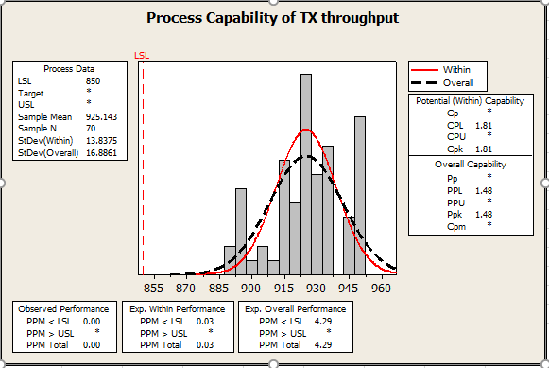
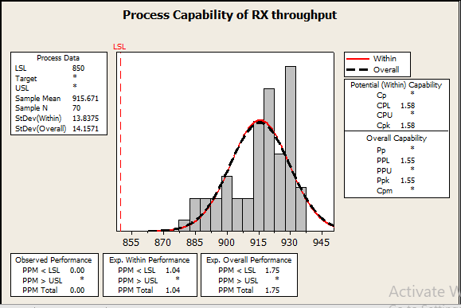
#4
CPK Verification -1
CPK TX,RX throughput data checking:
No.# | Items | CPK value | CPK picture | Remark
1 | TX throughput | 1.81 |  | All CPK value can meet target >1.33
2 | RX throughput | 1.58

Slide 6
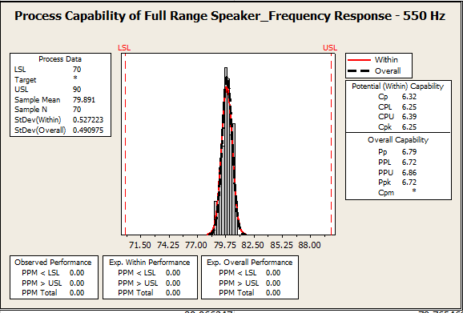
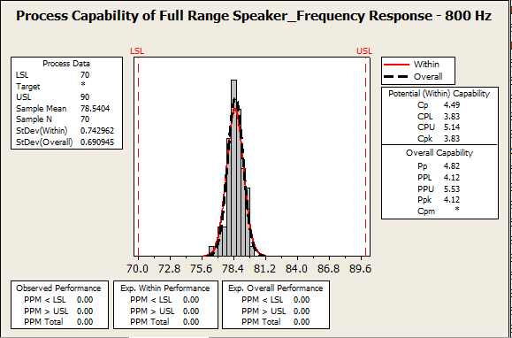
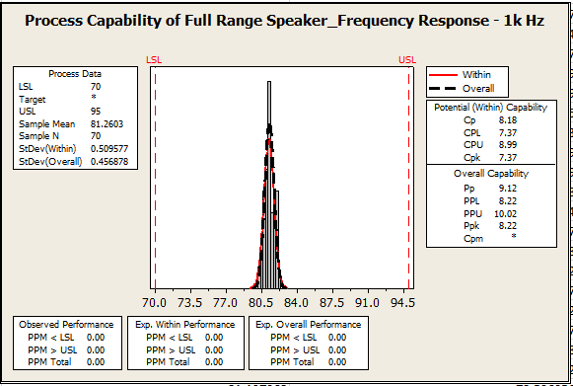
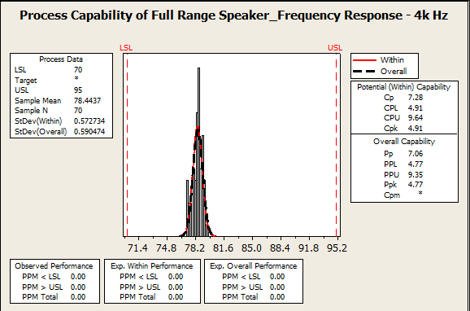
#5
CPK Verification -2
CPK AI soundbar data checking:
No.# | Items | CPK value | CPK picture | Remark
3 | Full Range Speaker Response Frequency 550 Hz | 6.25 |  | All CPK value can meet target >1.33
4 | Full Range Speaker Response Frequency 800Hz | 3.83
5 | Full Range Speaker Response Frequency 1k Hz | 7.37
6 | Full Range Speaker Response Frequency 4k Hz | 4.91

Slide 7
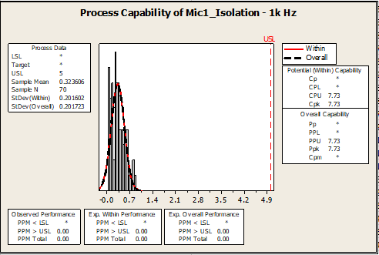
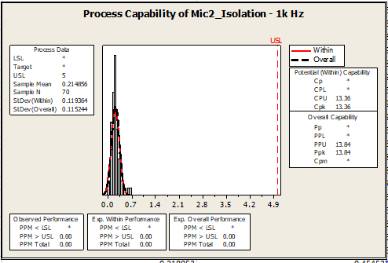
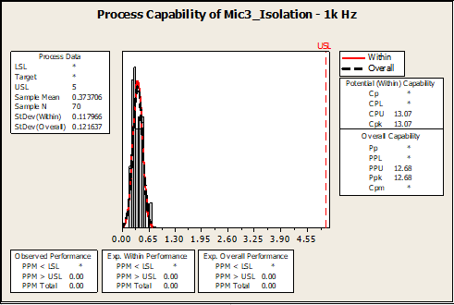
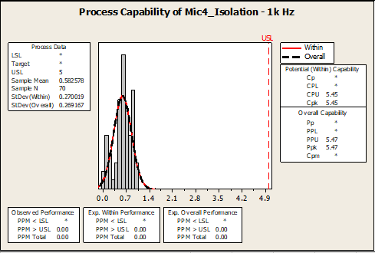
#6
CPK Verification -3
CPK AI soundbar data checking:
No.# | Items | CPK value | CPK picture | Remark
7 | Mic1 Isolation 1k Hz | 7.73 |  | All CPK value can meet target >1.33
8 | Mic2 Isolation 1k Hz | 13.36
9 | Mic3 Isolation 1k Hz | 13.07
10 | Mic4 Isolation 1k Hz | 5.45

Slide 8
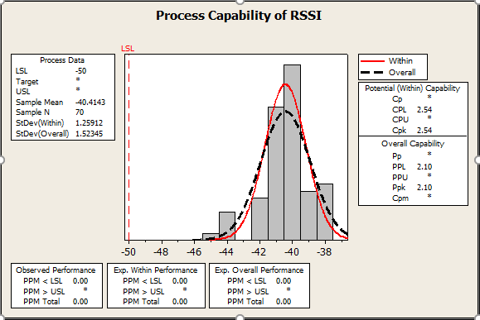
#7
CPK Verification -4
CPK Bluetooth RSSI data checking:
No.# | Items | CPK value | CPK picture | Remark
11 | Bluetooth RSSI | 2.54 |  | CPK value can meet target >1.33

Slide 9
#8
Control Run Result Summary
Control Run Result Summary:
1. FATP test yield rate was 100%. No found any failure relate to new test environment
2. OBA testing result: No abnormal issue found.
3. CPK data checking: Can meet target >1.33
Control Run Conclusion:
FII didn’t find out any abnormality related to new production line at F07-3F.
➔ We can apply new production line at F07-3F site for MP.

